Slide 1
RELAPSED PATIENTS DATA
SEM : 4 BATCH : D-1 TEAM NO : 09
CP_ID : 4DEDA_CP_08
NAME ROLL NO USN
Lavanya Shahapur 401 01fe20bcs185
Sindhu V Bhat 402 01fe20bcs186
Madhura Patil 403 01fe20bcs187
Pragati Pujari 405 01fe20bcs189

Slide 2

PROBLEM STATEMENT : To explore and analyze the dataset of the relapsed patients who took treatment for the deaddiction of alcohol and nicotine from a rehabilitation organization. DATA SOURCE : SDM Alcohol Deaddiction Camp Ujire,Dharmasthala,D.K DOMAIN KNOWLEDGE : Alcohol addiction or Alcoholism. Reasons behind people getting addicted to alcohol or drugs . Reasons behind people relapsing even after joining rehabilitation or alcohol deaddiction camps and taking treatment.
This Photo by Unknown Author is licensed under CC BY-ND

Slide 3
DATA UNDERSTANDING :
Attributes | Description
Age | Age of the person at the time of assessment.
Sex | Sex/gender of the person.
Education in year | The highest qualification of a person.
Occupation | The primary source of income.
Annual Income | The total income per year that a person earns.
Marital Status | Person’s Marriage Status. - Unmarried, Married, Divorced.
Living arrangement | The main support for that person’s livelihood. -Family, Friends, Relatives etc.
Referral | The referral reason for the person to join the camp.
Alcohol | The type of alcohol that person has consumed. - Beer, Whisky, Brandy etc.

Slide 4
AAO for alcohol in year | Alcohol Addiction offset indicates the age of the person when he/she started consuming alcohol.
Duration of excessive use of alcohol | The total time for which the person has consumed alcohol excessively.
Duration of use of alcohol | The total time for which the person has been consuming alcohol.
Average units used in last 30days | The average amount of alcohol consumed in last 30 days before the assessment.
Last drink_Date | The last day when the person had alcohol.
Assessment Date | The date of assessment held.
Quantity of last drink | The amount of drink consumed in the last drink.
Reason for starting alcohol | The cause for starting consuming alcohol.
Reasons for continued use of alcohol | The factors which influenced the continuation of alcohol
Nicotine (yes/NO) | The consumption of Nicotine. -Yes if consuming and No, if not.
smoking/smokeless | Whether the person was smoker or not.

Slide 5
Quantity/day | The amount of smoking done per day.
Last Use | The last date when the person smoked.
Stressors | Something that causes a state of strain or tension to make the person addicted to alcohol or substance use
Impression of Camp officer about patient | The feeling of the Camp officer towards the patient.
Denial of substance use related problems | Denial is when someone ignores, downplays, or distorts reality or Refusal to admit the truth or reality of the condition which is seen in alcohol addicts.
Motivation factor | The feeling of the person and its extent which triggered Him to join the camp. -Low, Moderate, High
Willingness for treatment | The feeling or wanting to take treatment that a person has. –Willing, Unwilling, Ambivalent.
Action Taken | The action taken by the patient. – Admitted or not.
Weight while admission (In Kg) | Weight at the time of admission to the camp.
Weight while discharge (In Kg) | Weight after the treatment.

Slide 6
Height(In Ft) | Height of the patient.
Sugar(mg) | Sugar level of the patient.
Other Issues | Any other health related issues.
Withdrawal symptoms experience | These are the physical and psychological experience person experiences when he/she stops drinking.
Medical Problem experienced(Past ) | Medical problems present in the past.
Medical Problem experienced(Present) | Medical problems present at the time of assessment.
Chronic health problem | Severe health issues of the patient.
Psychiatric complication_Past | Mental health issues present in the past.
Psychiatric complication_Present | Mental health issues present at the time of assessment.
History of previous head injuries, if any | If patient had any head injuries before, then mention it.
Knowledge of allergy to specific drugs(if known) | The allergic conditions of the person to drugs.
Family history of alcoholism / drug abuse, if any (who and which type of drug) | The person who was addicted to alcohol in the family and the type he consumed.
If any SpecV(Who and which type of drug) | The person who was addicted in the family and the drug he/she consumed.

Slide 7
Family history of psychiatric illness in family, if any specify (who) | The history of the person’s family who had mental health issues.
Any untoward incident occurred during treatment(Yes/No): If Yes Then Describe: | The bad incident or misery which took place during treatment.
Action Taken | Whether the person took admission or not.
Past deaddiction treatments received/not | Whether the person had taken treatment earlier.
Name of the Hospital/ Deaddiction Center | Name of the center where he took treatment.
Year of Treated | The year of the treatment taken.
Period of Treatment | The duration of the treatment taken.
Period of sober | Refers to someone having an extended period without alcohol or other drugs in their body.
Remark | The remarks which helped to overcome addiction.
Record extra marital experiences | The person’s extra affairs if present.
If unmarried, premarital sexual encounters | Any sexual experiences before marriage.
Have you involved in any high risk sexual activities | The person’s sexual activity status.

Slide 8
At present do you have any sexual problem ( if yes mention) | The sexual problems the patient has presently.
SPOUSE RELATIONSHIP :
Name | Name of the patient’s spouse.
Age | Age of the patient’s spouse.
Religion/Community | Religion of the patient’s spouse.
Education | Education of the patient’s spouse.
Occupation | Occupation of the patient’s spouse.
Monthly Income | Monthly income of the patient’s spouse.
Arranged Marriage/Love marriage | The type of marriage they had.
Number of year of marriage | The duration of the marriage.
Multiple marriages | The patient had multiple marriages or not.
Have you been separated from your spouse due to your addiction | The marriage condition of the patient.
Are you suspicious of your wife | The person’s feeling towards his/her spouse.
Any instance of family violence | The instance of family violence if occurred.

Slide 9
Specify nature of current work | The nature or type of the work patient does.
At what age did you start working? | The age when patient started working.
How long have you been working? | The time for how long the patient has been working.
Have you received any special award, recognization, merit certificates or promotions | The patient’s achievement and promotions if any.
Did you change Your job frequently due to addiction? | The patient’s job status.
Did you have any period of unemployment? If yes how long and for what reasons? | The time of unemployment, if happened and the reasons for it.
Occupational damage | The condition of patient’s occupation.
Details of Debts to be cleared. If any mention the amount | The bank and debt details of the patient.
Legal complications yes/no If yes mention | The legal complications patient has.
Describe your childhood / teenage year? Did you experience the following | The childhood feelings and behavior of the patient.
Behavior problem identified in Childhood/ Adolescence | The problems and changes patient faced in teenage.

Slide 10
Achievements in the Education | The patient’s achievements in education
year of Education | The year of education.
High achiever in extracurricular activities | The achievement in extra curricular Activities.
Religious beliefs and behavior: Are you a believer/ non believer/ indifferent | Beliefs of the patient with respect to religion.
Past Treatment History | The past treatment details.
Psychological factors of substances use continuation and relapse | The aspects which influenced the continuation of alcohol.
Maximum period of abstinence and possible factors for abstinence | The maximum duration the person avoided alcohol and its causes.
Significant Psychosocial problems | The important and severe mental health problems the patient had.
Final Diagnosis Full | The full diagnosis report.
Clinical Global Impression | The scale to quantify and track patient progress and treatment response over time.

Slide 11
FAMILY HISTORY :
Patient Relationship | Living / Dead | History
Father / Mother Brother / Sister / Uncle Spouse / Aunt/ Children | Living
 | Age
 | State Of Health
 | Yes | Consumes alcohol
 | No | Not consumes alcohol
 | Don’t know | Information not known
 | Dead
 | Year Of Death
 | Cause of Death
 | Patient Age at Death
 | Yes | Consumed Alcohol
 | No | Not consumed Alcohol
 | Don’t know | Not known

Slide 12
QUESTIONNARE : 1. Little interest or pleasure in doing things? 2. Feeling down, depressed, or hopeless? 3. Feeling more irritated, grouchy, or angry than usual? 4. Sleeping less than usual, but still have a lot of energy ? 5. Starting lots more projects than usual or doing more risky things than usual? 6. Feeling nervous, anxious, frightened, worried, or on edge? 7. Feeling panic or being frightened? 8. Avoiding situations that make you anxious? 9. Unexplained aches and pains (e.g., head, back, joints, abdomen, legs)? 10. Feeling that your illnesses are not being taken seriously enough ? 11. Thoughts of actually hurting yourself? 12. Hearing things other people couldn’t hear, such as voices even when no one was around? 13. Feeling that someone could hear your thoughts, or that you could hear what another person was thinking?

Slide 13
14. Problems with sleep that affected your sleep quality over all? 15. Problems with memory (e.g., learning new information) or with location (e.g., finding your way home)? 16. Unpleasant thoughts, urges, or images that repeatedly enter your mind 17. Feeling driven to perform certain behaviors or mental acts over and over again? 18. Feeling detached or distant from yourself, your body, your physical surroundings, or your memories? 19. Not knowing who you really are or what you want out of life? 20. Not feeling close to other people or enjoying your relationships with them? 21. Drinking at least 4 drinks of any kind of alcohol in a single day? 22. Smoking any cigarettes, a cigar, or pipe, or using snuff or chewing tobacco? 23. Using any of the following medicines ON YOUR OWN, that is, without a doctor’s prescription, in greater amounts or longer than prescribed [e.g., painkillers (like Vicodin), stimulants (like Ritalin or Adderall), sedatives or tranquilizers (like sleeping pills or Valium), or drugs like marijuana, cocaine or crack, club drugs (like ecstasy), hallucinogens (like LSD), heroin, inhalants or solvents (like glue), or methamphetamine (like speed)]?

Slide 14
DATA SET ANALYSIS : The given dataset contains (89 rows X 202 columns). There are 541 NULL values in the whole dataset. With some preliminary cleaning done on the dataset, we have added two additional columns named “Age Group” and “AAO category” which categorizes the numerical data(Age) into categorical data groups as youth, adults and seniors. While there is an unnamed column or attribute in the data set which contains 28 null values . As this attribute adds no value for our analysis , we have removed this column.

Slide 15
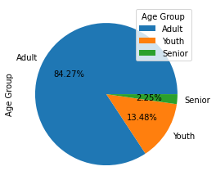
The pie chart depicts the additional column of Age group added. It categorises the numerical “AGE” attribute into categorical data. Thus dividing it into groups of Adults(30-60years), Senior(more than 60 years) and Youth(less than 30 years). There are 75 adults in the data set and thus contributing of the 84.27% of the sample population. While there are two senior people in the whole data set constituting of 2.25%. And 13.48% of youth are present i.e there are 12 youths in the data set.

Slide 16
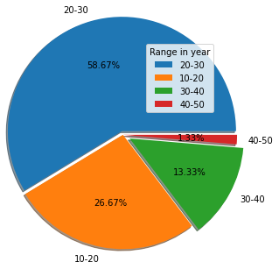
The pie chart shows the Relation of the attribute “AAO of Alcohol” along the range of years. Thus it is found that more number of patients have started consuming alcohol in their 20-30’s of age i.e constituting up to 58.67% of population of the data set. While 26.67% have started consuming in their 10-20’s of age. Thus it is evident that the offset of alcohol consumption has occurred in the early age for more than half of the population of the given data set.

Slide 17
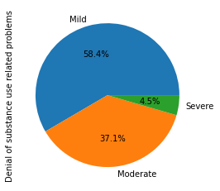
The Pie Chart depicts the percentage of the occurrence of denial of substance use in the patients. 58.4% people experience mild range of denial of substance use related problems i.e more than half of the population experiences mild rather than severe or moderate problems.

Slide 18
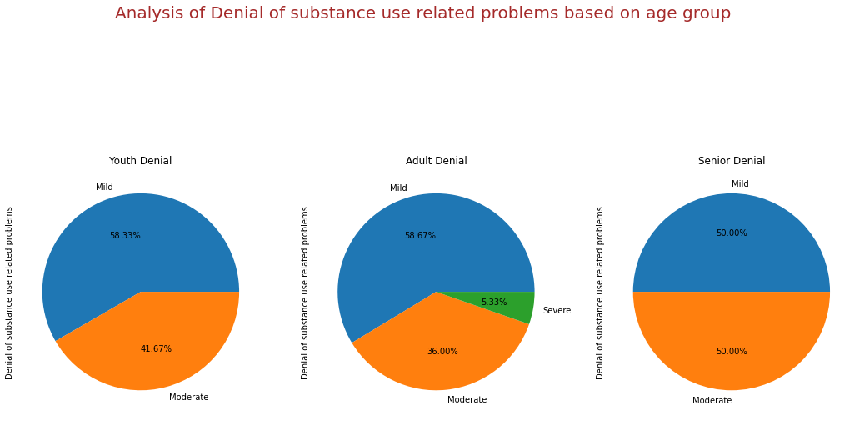

Slide 19
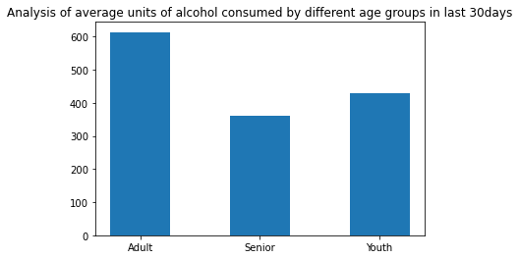
The bar plot interprets the relation of the attribute “average alcohol consumed in last 30 days” with the “age group”. Thus it is seen that adults have consumed on an average of 613.467 ml of alcohol in the last 30 days before the assessment while youths have consumed 427ml of alcohol and seniors have consumed 360ml of alcohol. We can interpret that adults contribute about 43.78% of average consumption of the alcohol with respect to the last 30 days.

Slide 20
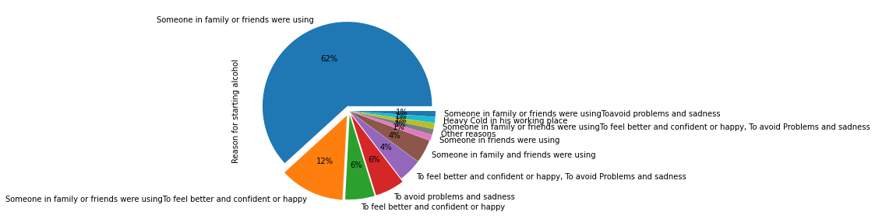
The pie chart shows the variation of the reasons of the patients cause for starting of alcohol. Among that 62% constitute the reason “Someone in friends or family were using”. This factor has influenced people more than any other factor. And 12% people have been influenced by the “Someone in family or friends were using, to feel better and confident or happy”.

Slide 21
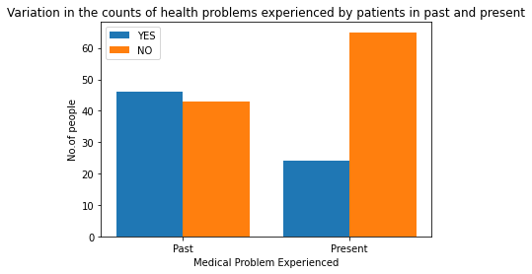
The bar plot shows the variation of the count of the people who have experienced the past health problems and also the people who were experiencing health problems(present condition) during the course of assessment. In the past condition : There are 43 people with no health issues , while there are 46 people with health problems. In the present condition : There are 65 people with no health issues, while there are 24 people with health problems.

Slide 22
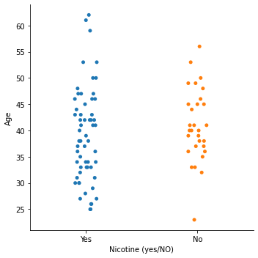
This is the catplot plotted against “Age” attribute with “Nicotine(yes/No)” attribute to find out the count of the people who consume nicotine along with alcohol or substance. From the plot we find that 59 people of the given data set i.e 66.29% of the population consume nicotine along with alcohol. And remaining 33.71% of the population consumes only alcohol and not nicotine.

Slide 23
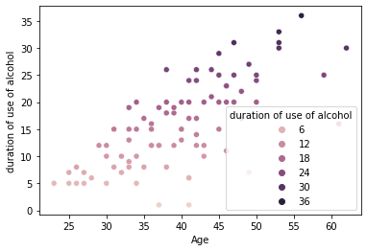
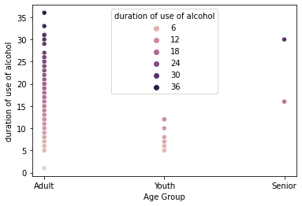
These two scatter plots shows the correlation between the duration of consumption of alcohol done by the people according to there age and age groups. The maximum duration of consumption of alcohol done by a person is 36 years (and he is an adult) in the data set and while minimum duration of consumption of alcohol done by a person is 1 year and he is an adult(can be interpreted from the graph).

Slide 24
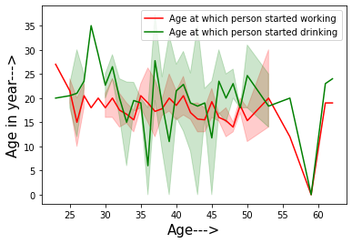
The line graph depicts the comparison between the age of person at which he has starting working with the age at which he has starting drinking. Majority of the patients have got addicted only after they started earning. There is one Nan value identified.

Slide 25
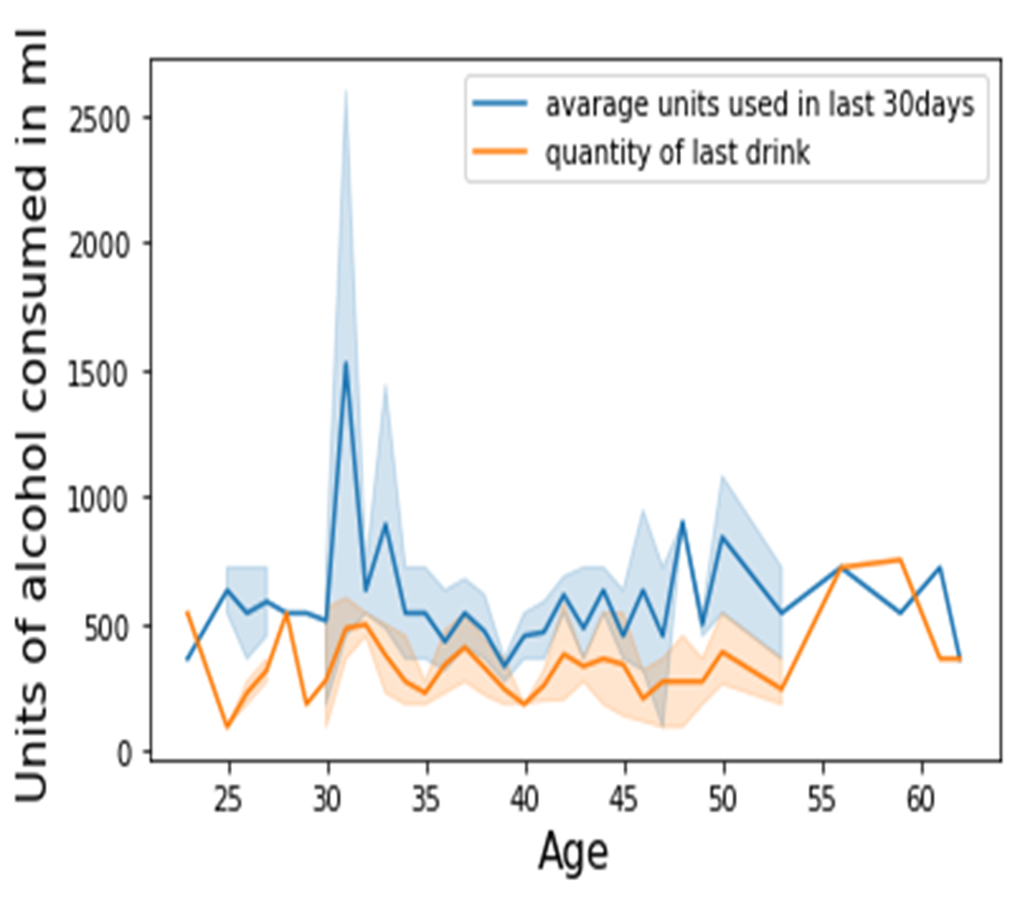
The line graph shows the variation in recent drinking habits with average units of consumption in the last 30 days. We can see that the people of age group 25-54 have reduced the consumption whereas people of age group 55-60 and above have increased drinking.
There is an outlier of 1500 ml of average consumption which exceeds the normal limit of consumption of alcohol for a person.

Slide 26
Some Key Analysis on the data set : In the data set, there are 79 patients who have relapsed once after taking treatment for a certain period of time. While there are 10 patients who have relapsed twice back to alcohol consumption after taking treatment twice and being in sober period for some duration. The reasons that have made the people to relapse back to alcohol consumption majorly include medicine effects, psychological reasons like friendship issues, for happiness and because of the stressed life. Among these patients , there are 69 patients who joined for the treatment were willing to take treatment and 14 people were ambivalent to take the treatment. And 6 people were unwilling to take the treatment but were admitted by their family/friends/well wishers.

Slide 27
FURTHER ANALYSIS
Removing NULL values or filling the missing values with appropriate data using standard preprocessing techniques.
Finding correlation among the attributes and combining the closely related data as a measure of reducing the data.
Cleaning the data. Ensuring the attributes contain appropriate data and not any random erroneous data or values of other attributes.
Selecting different attributes and analyzing the relation between them and inferring the result we get.
Explore the data with different plots and graphs . Identifying outliers and eliminating them.
Infer the reasons for the patient to relapse. How the person’s personal and professional life has influenced his sobriety and in relapsing.
Exploring the questionnaire or DSM5 measure.

